Slide 1
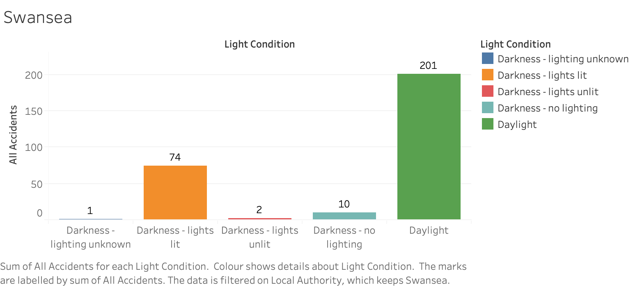
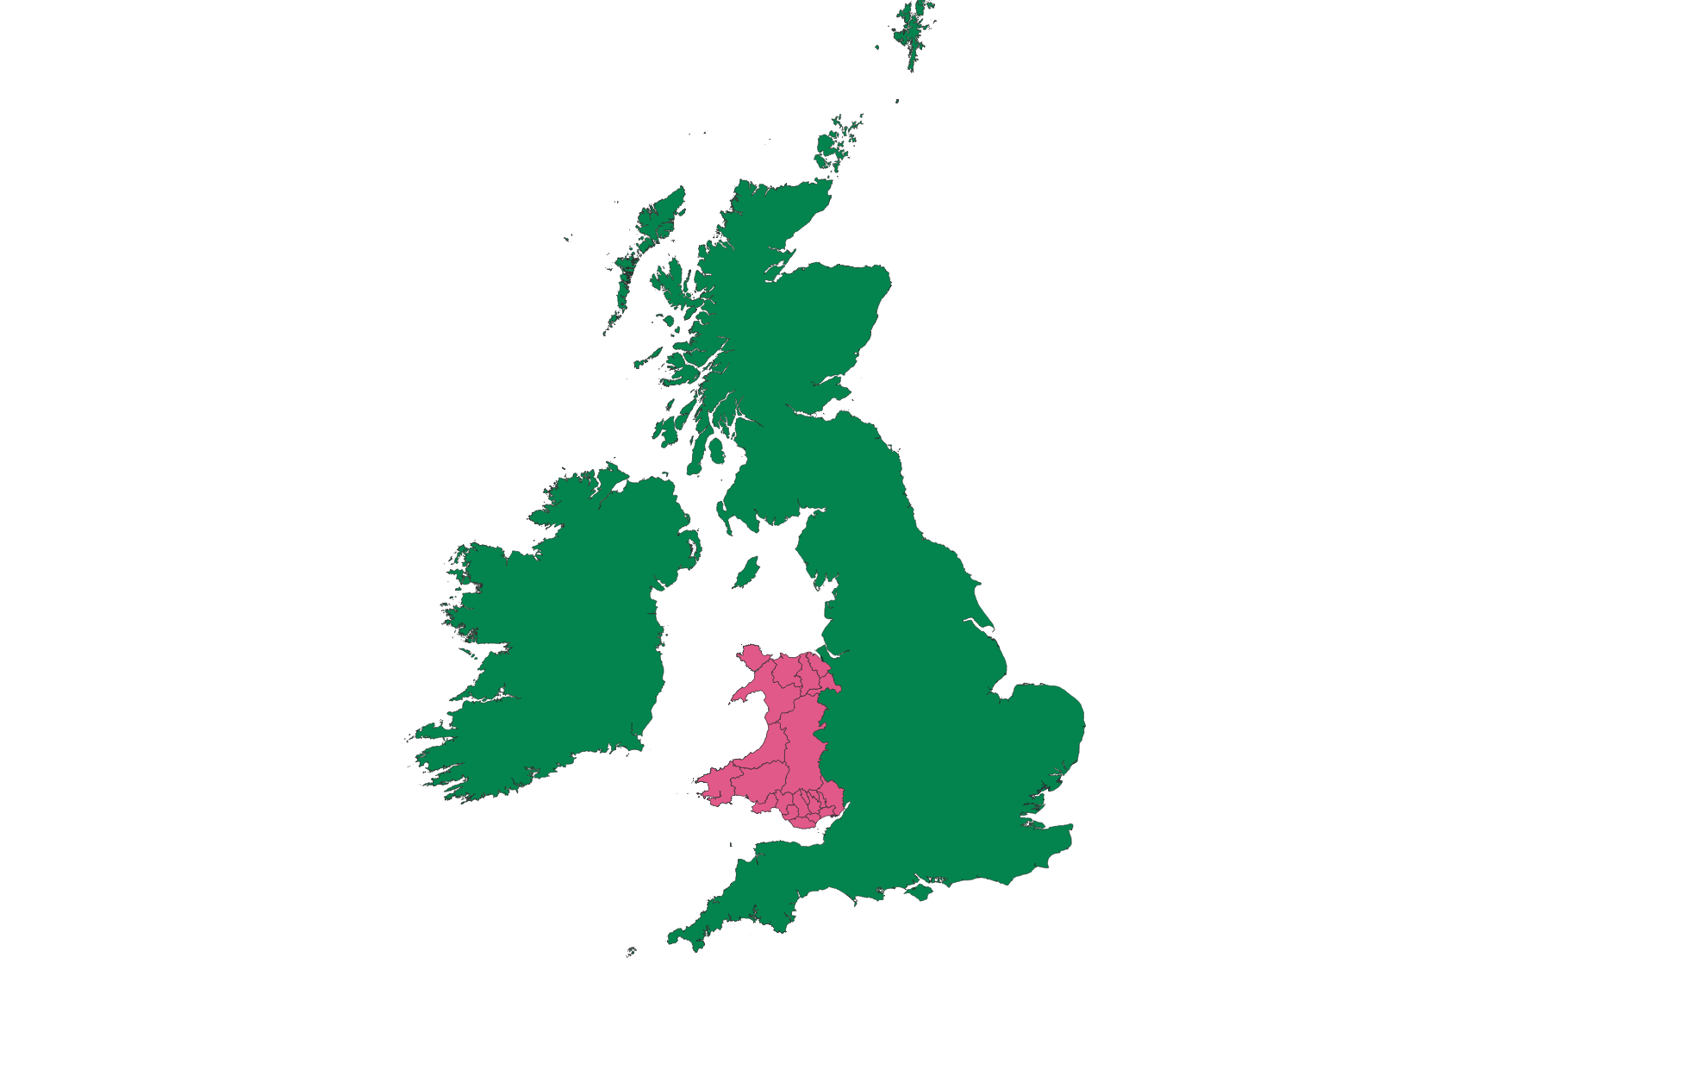
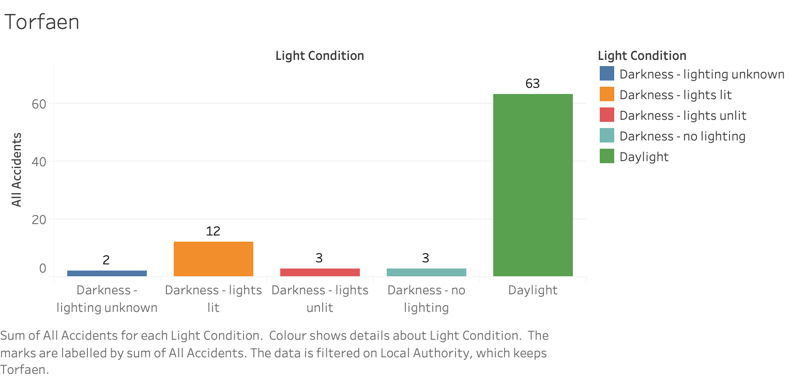
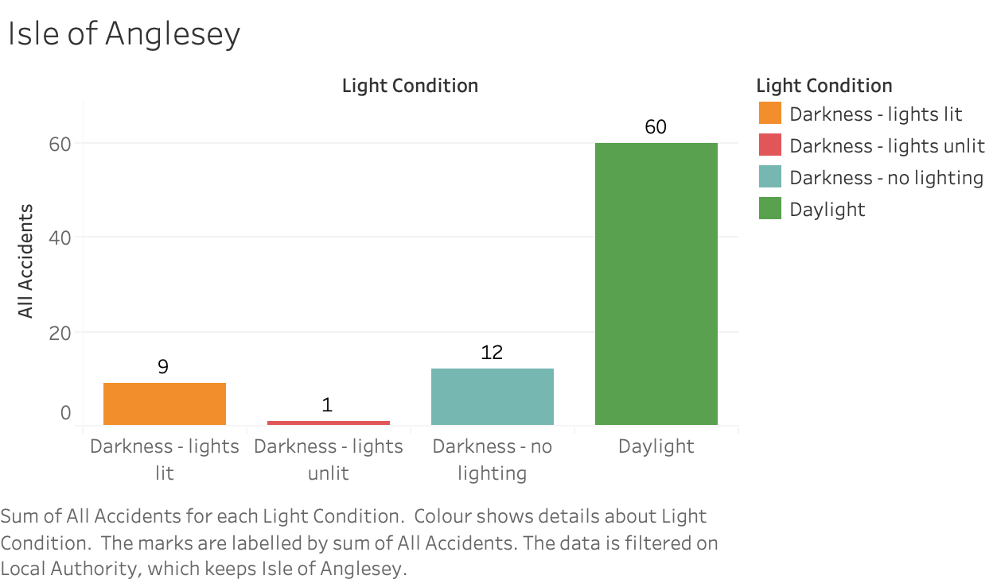
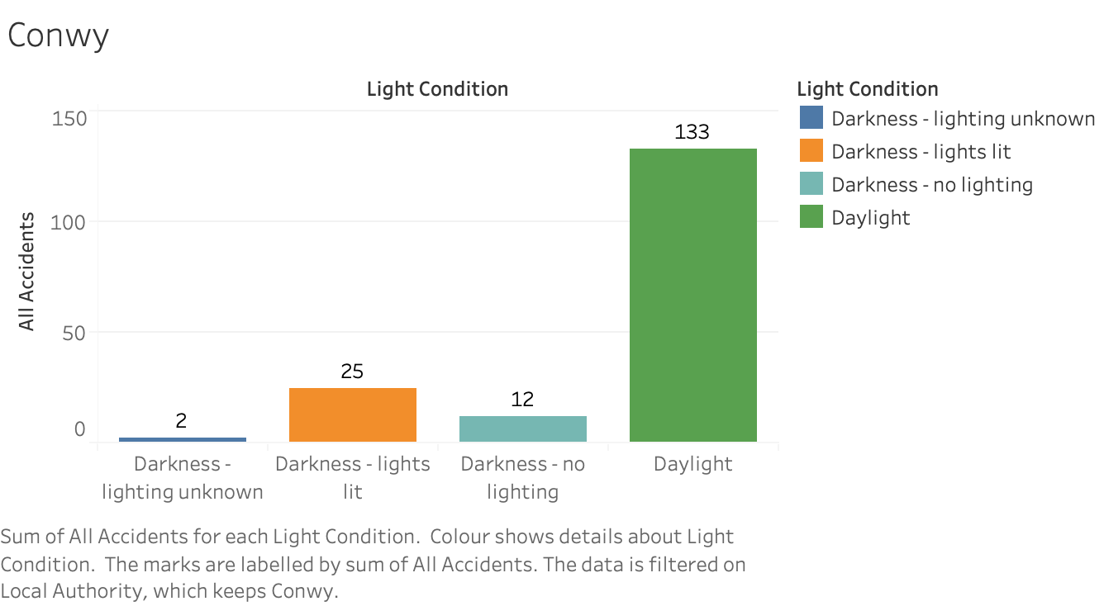
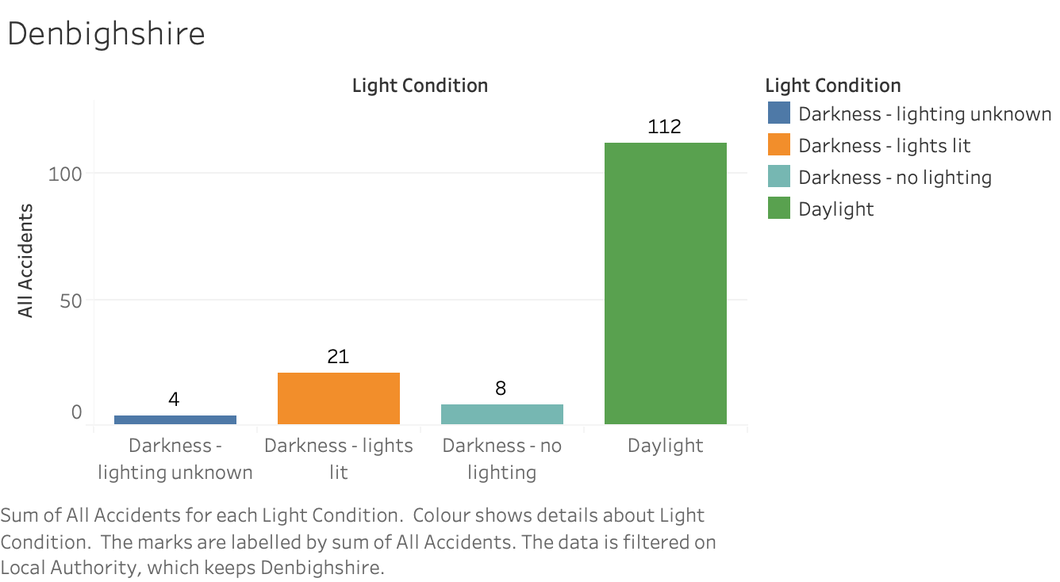
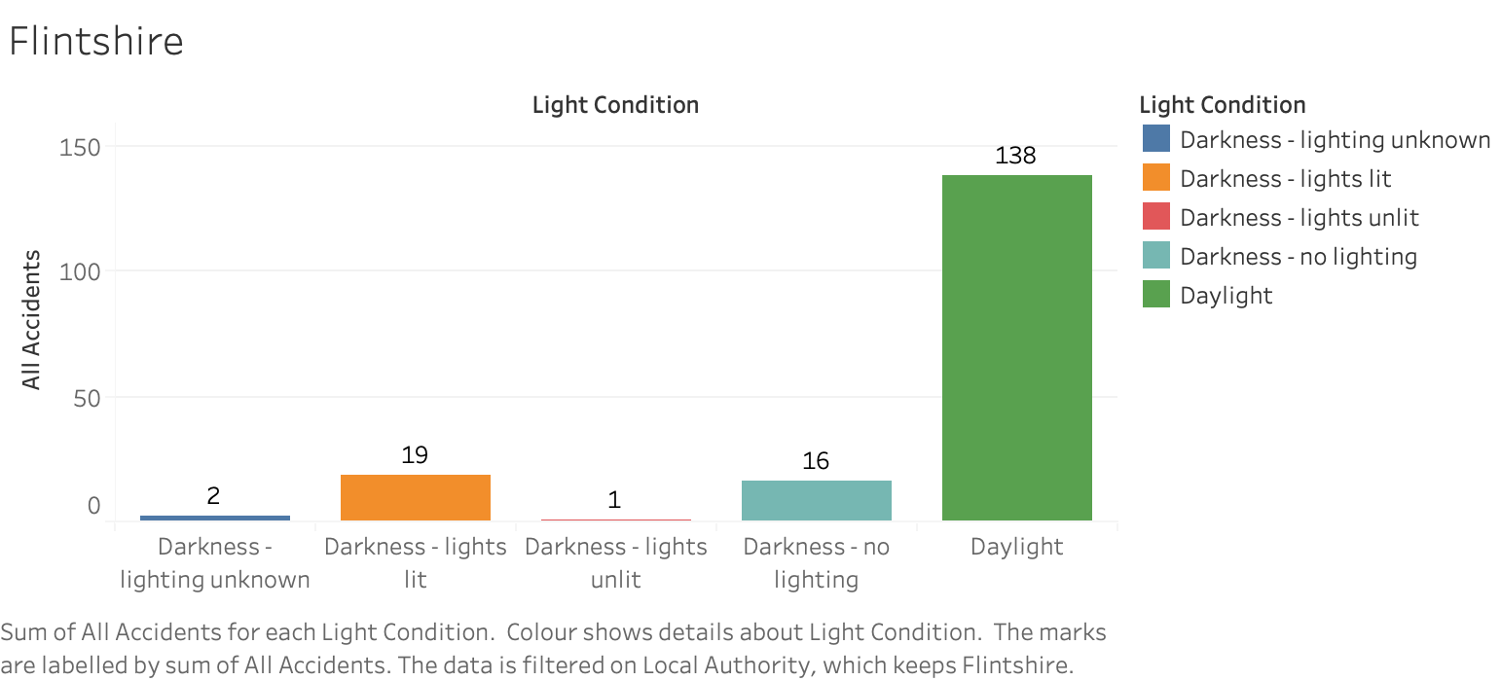
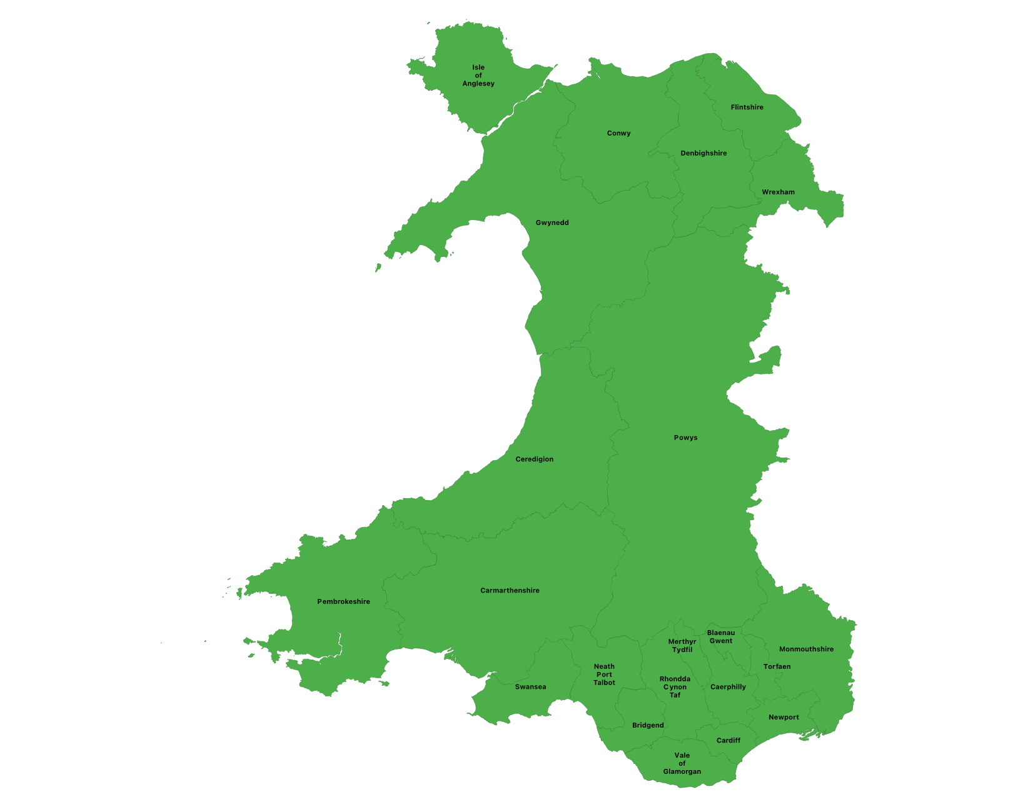
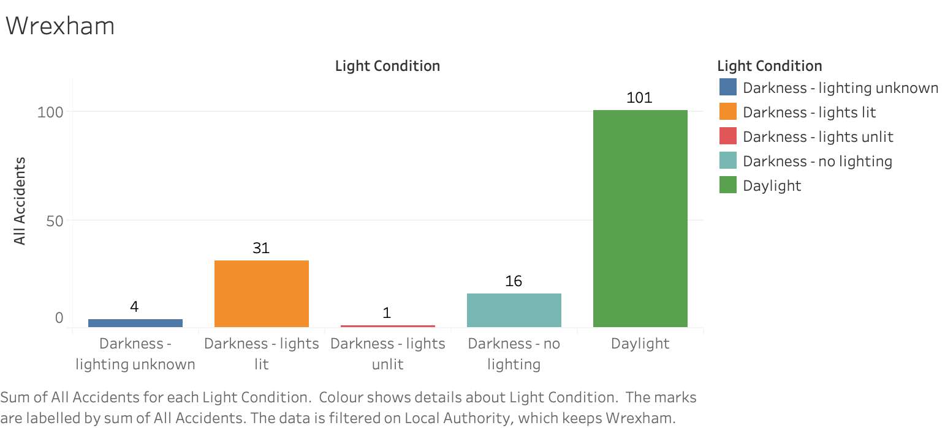
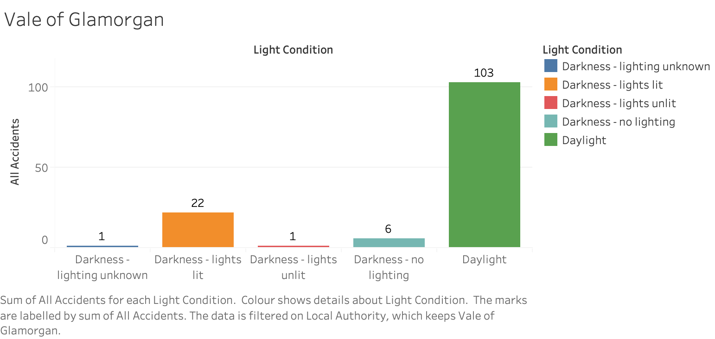
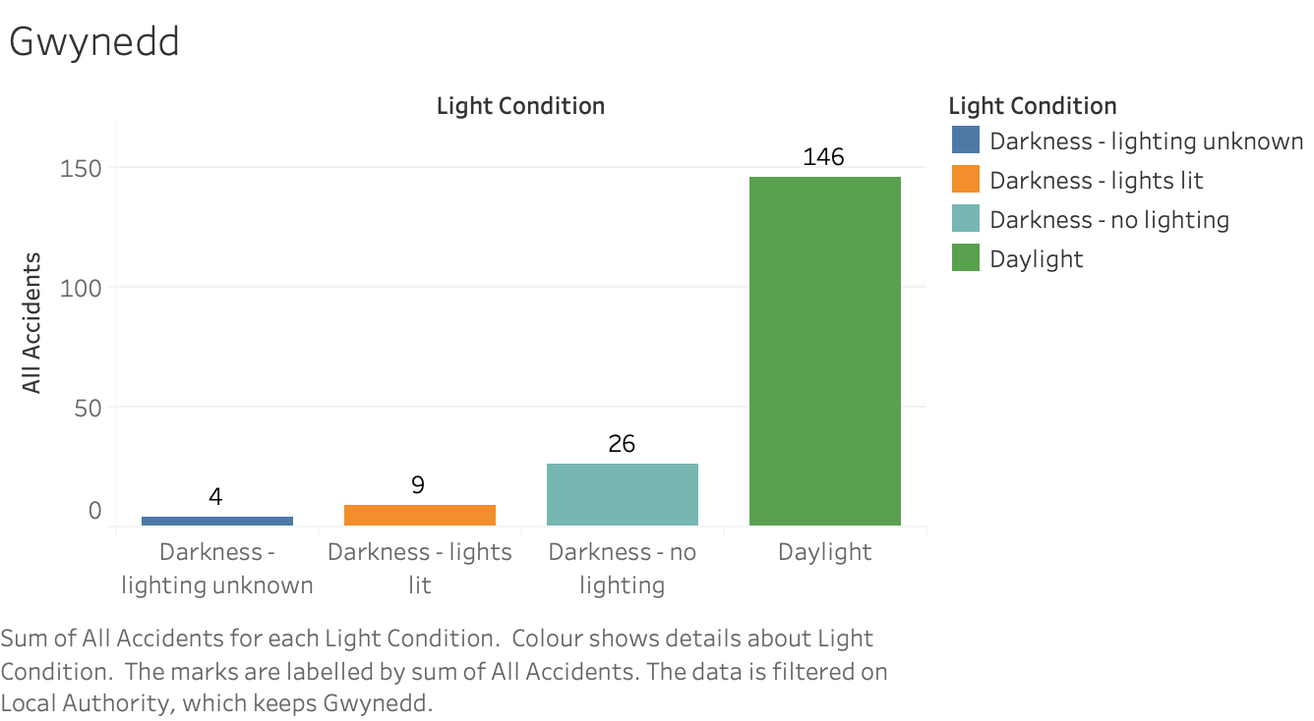
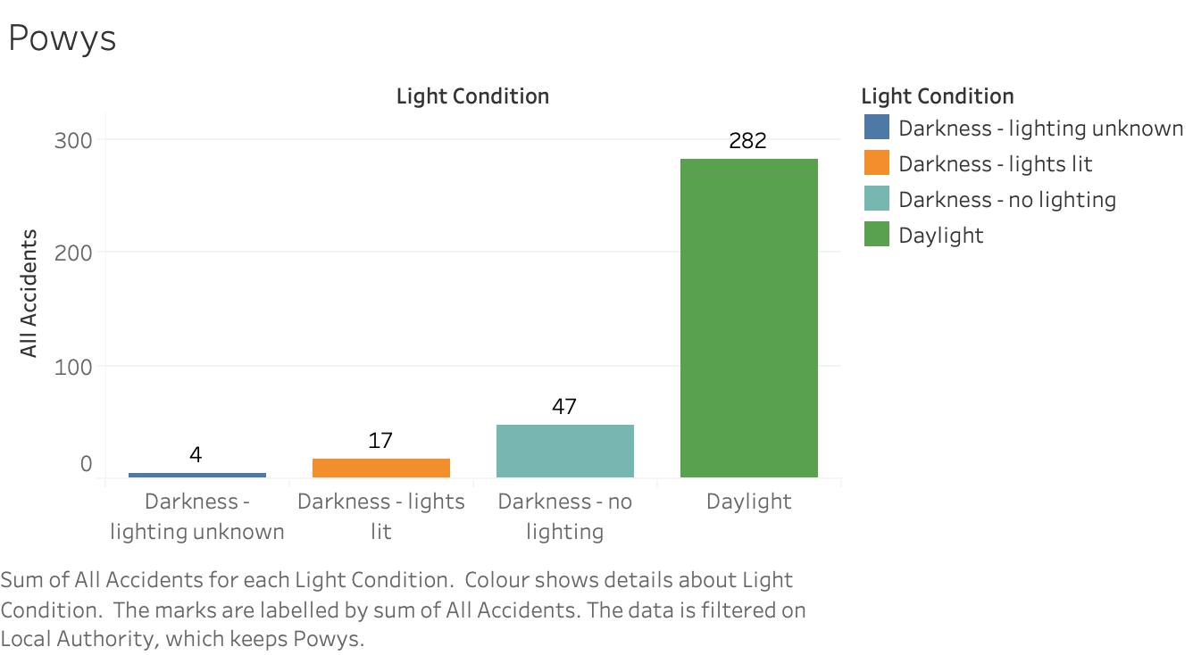
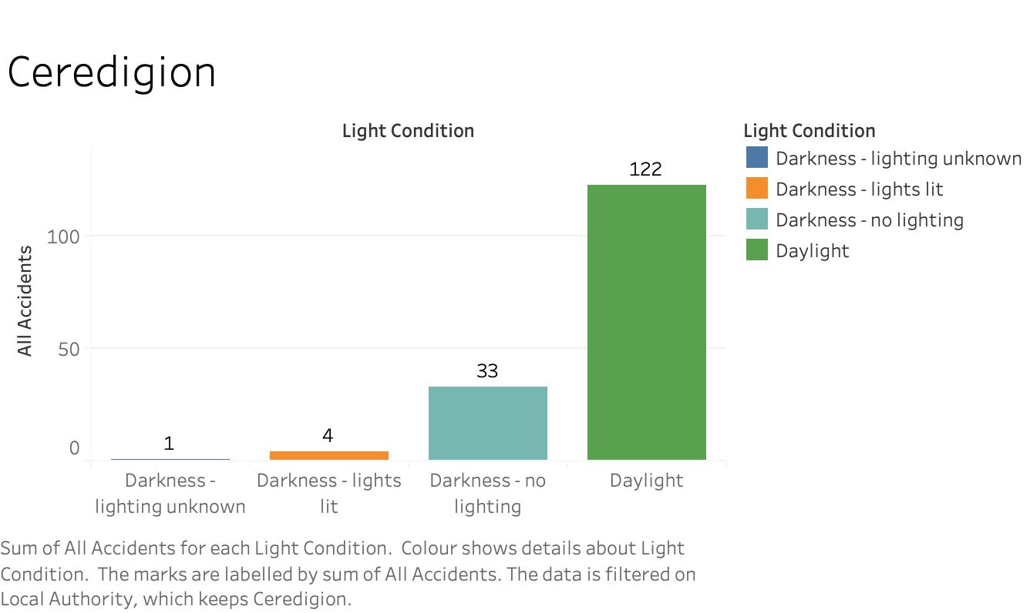
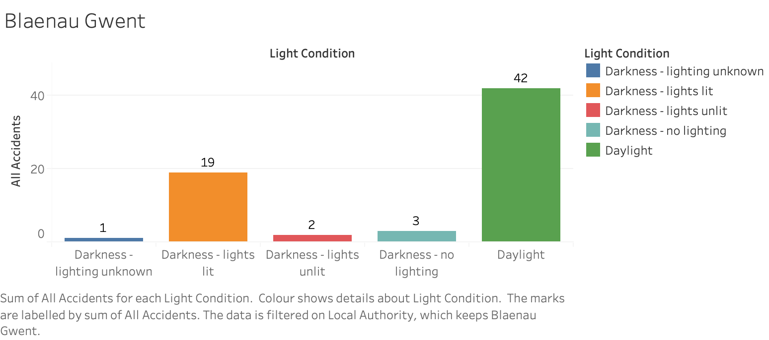
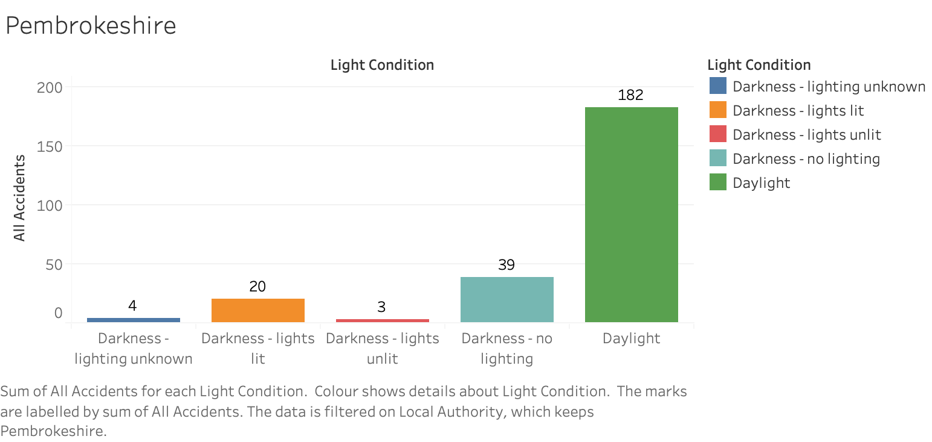
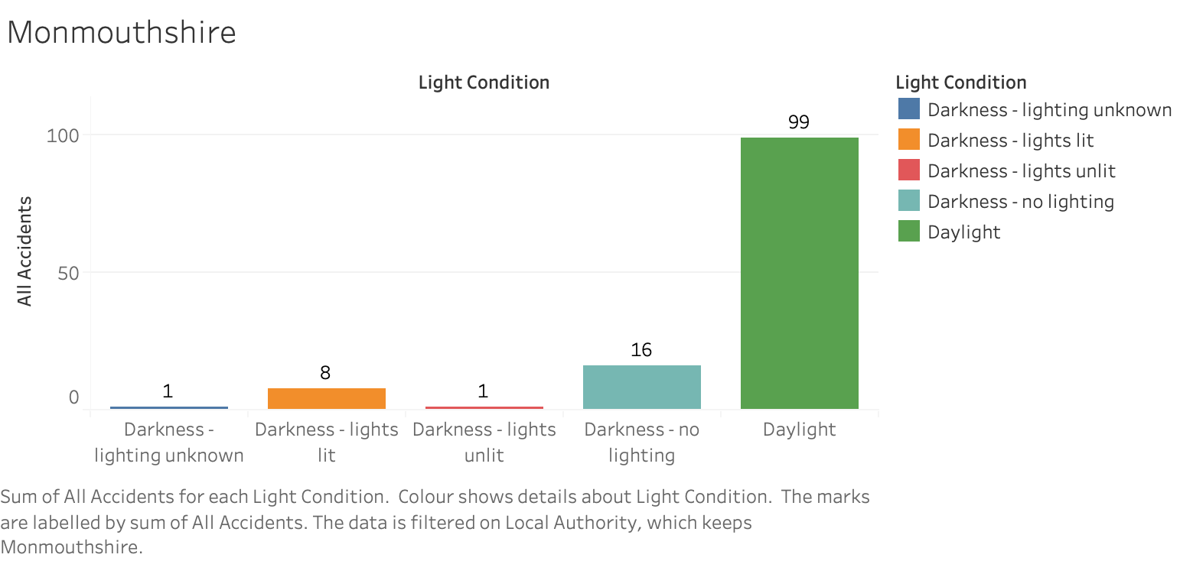
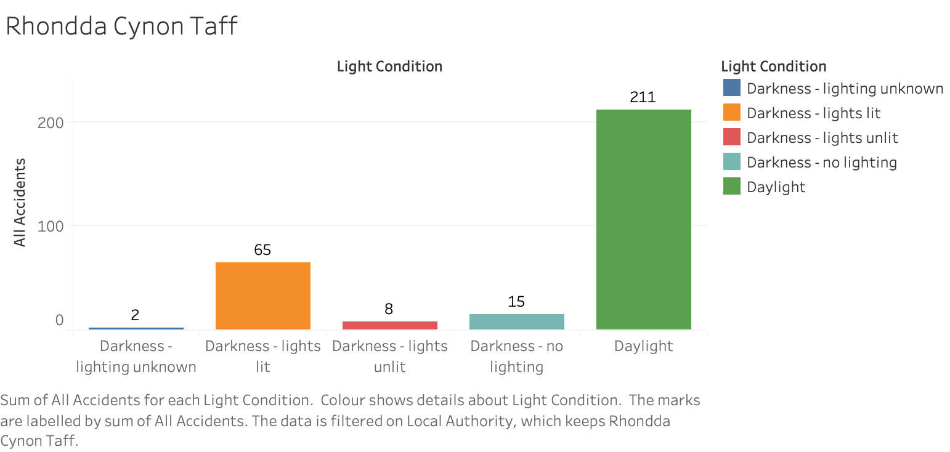
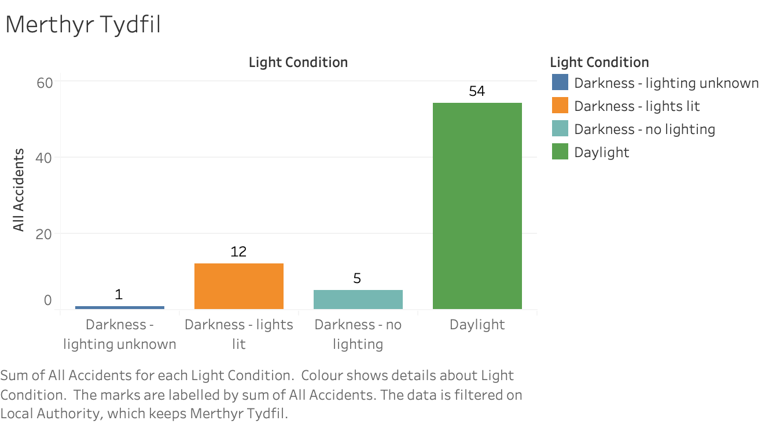
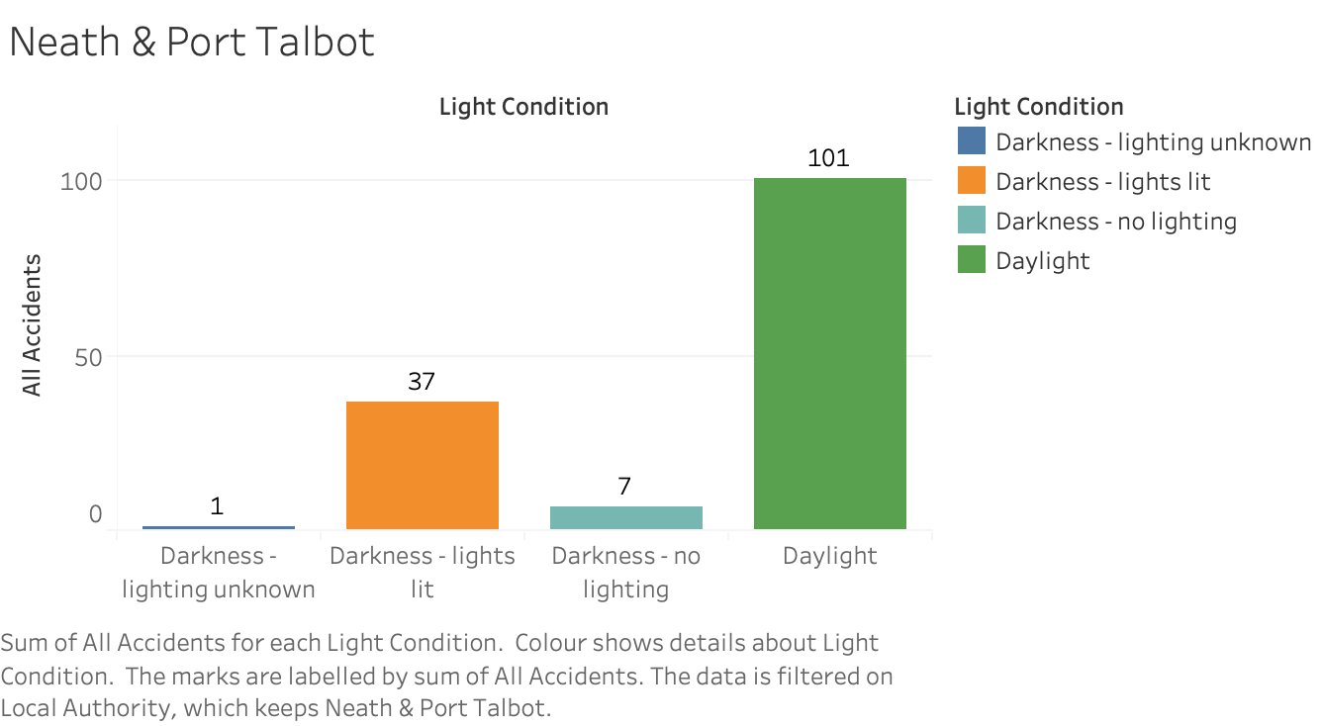
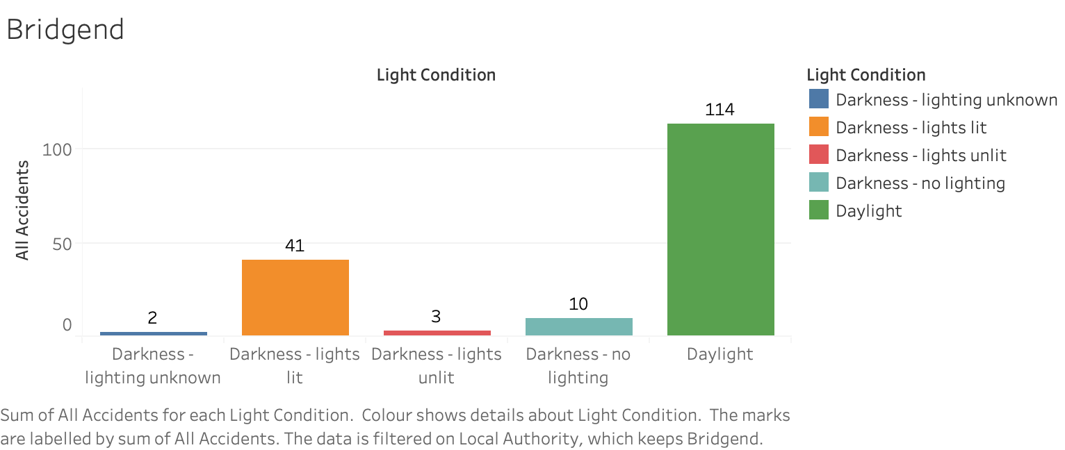
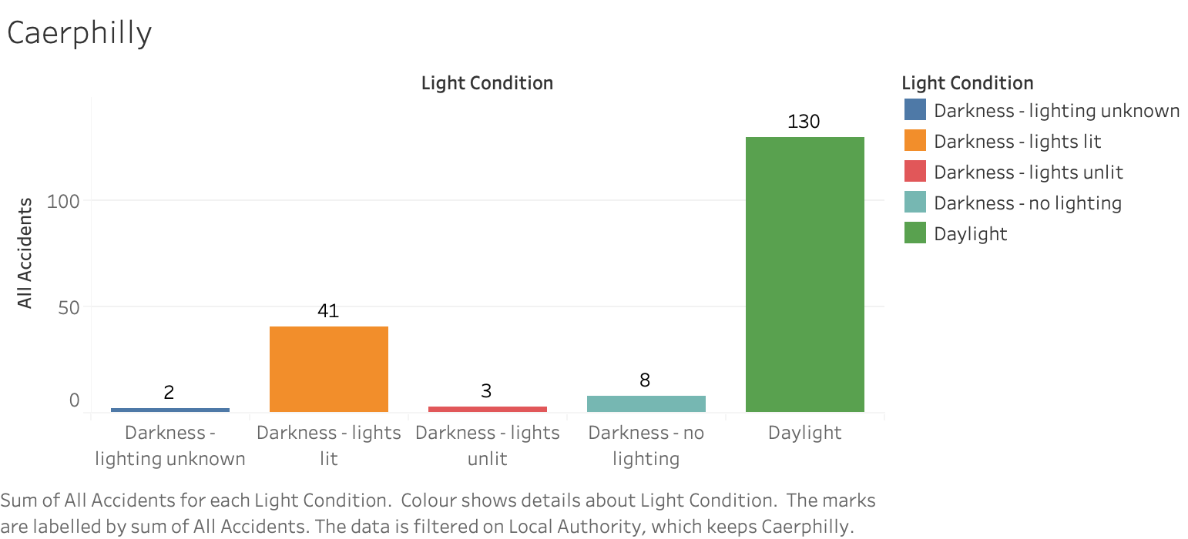
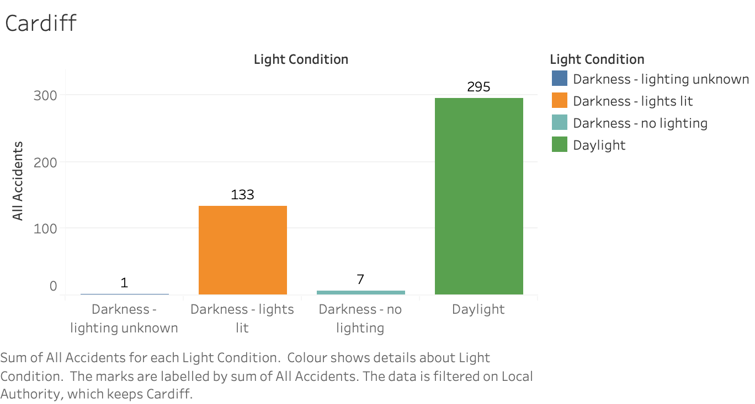

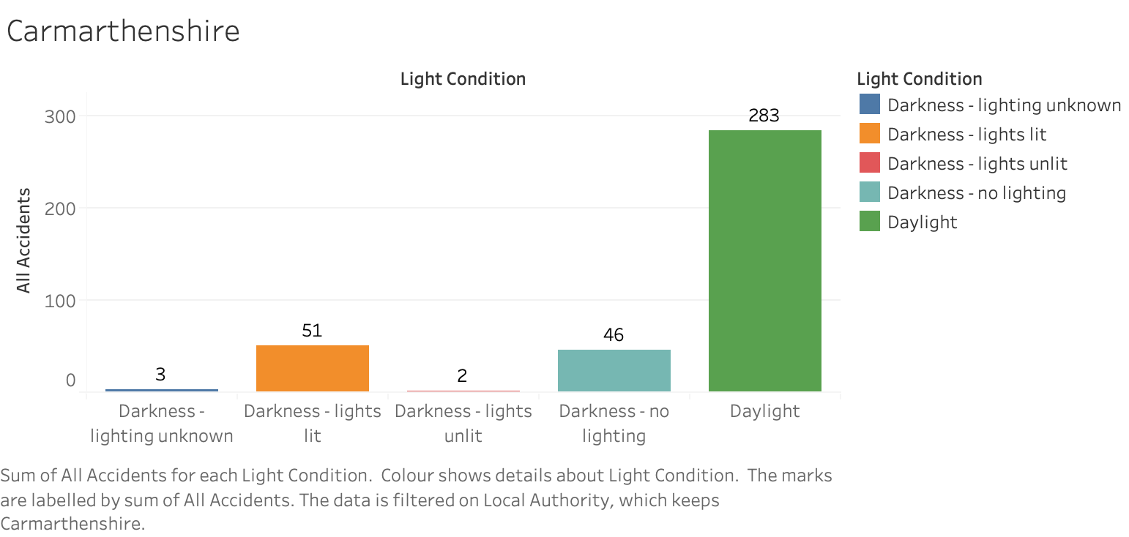
Total Crashes to Light Conditions.
Give a brief ocverview

Slide 2
Total Crashes to Light Conditions.
Give a brief ocverview

Slide 3
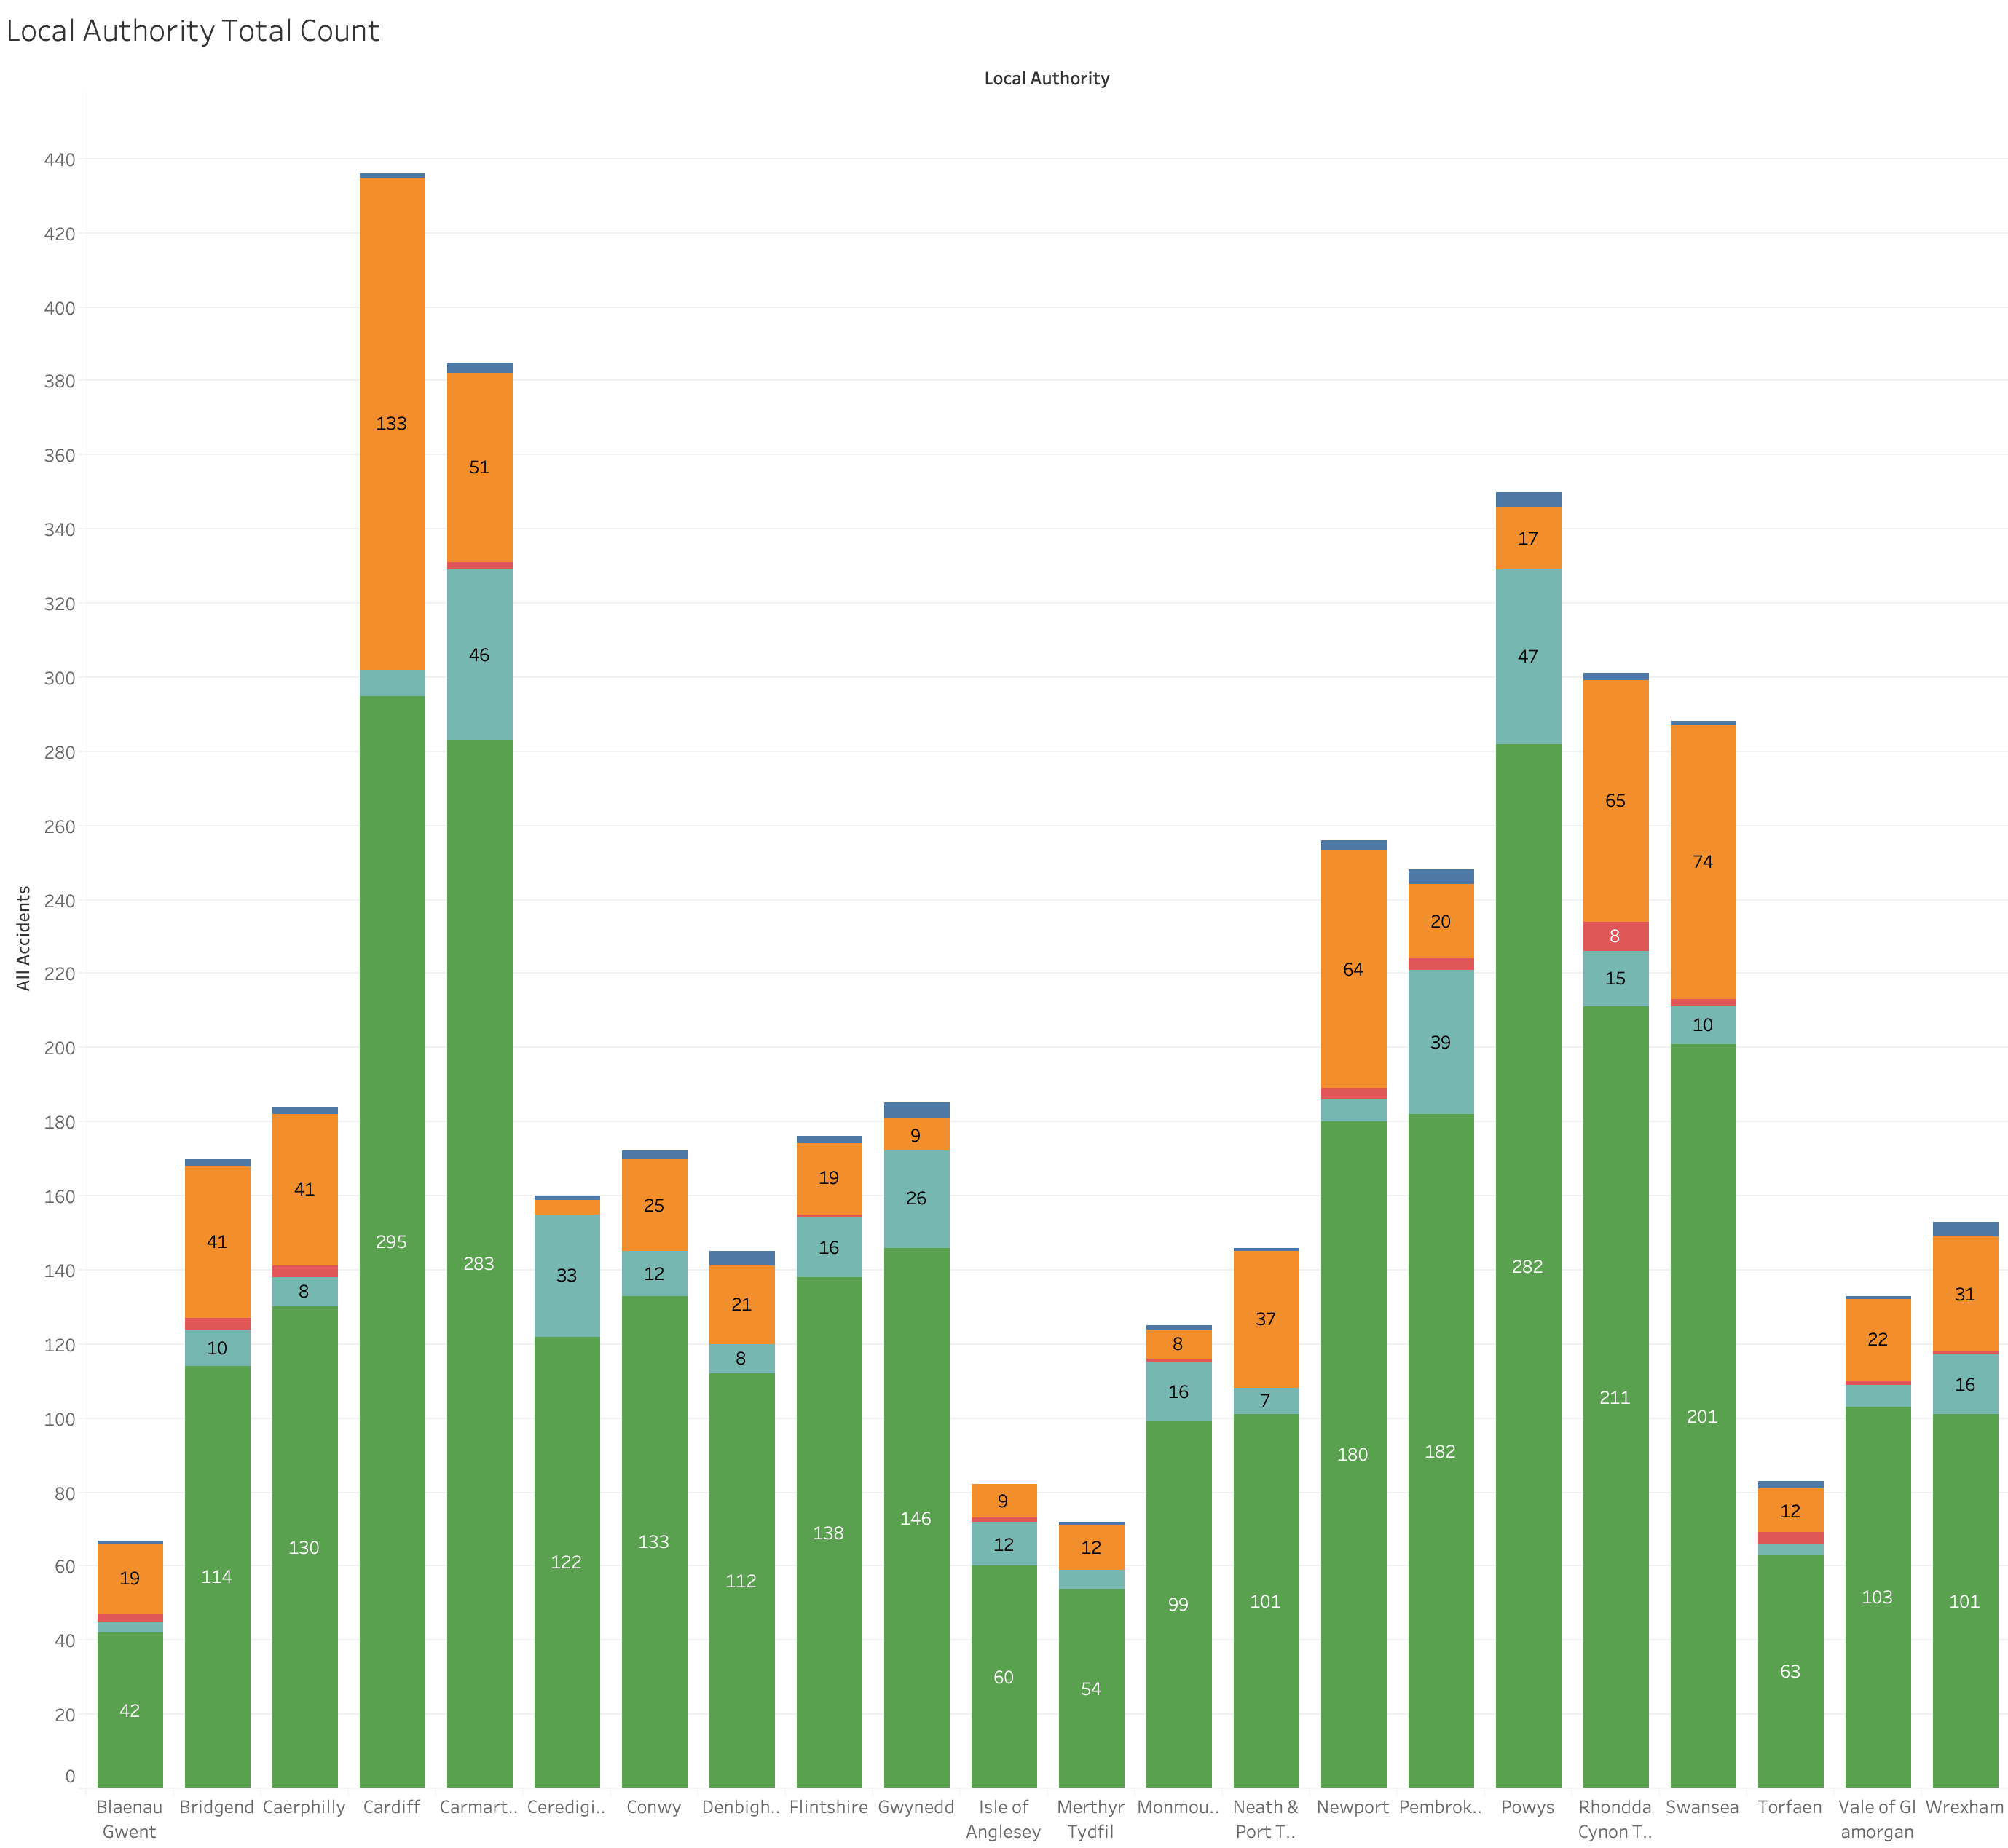
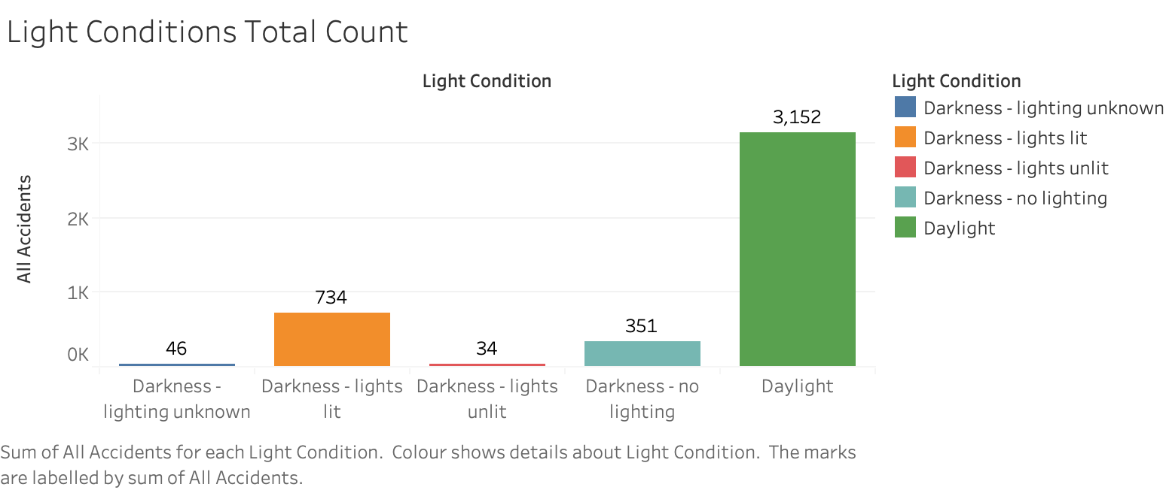
Total Crashes to Light Conditions.
Give a brief ocverview

Slide 4
Total Crashes to Light Conditions.
Give a brief ocverview

Slide 5
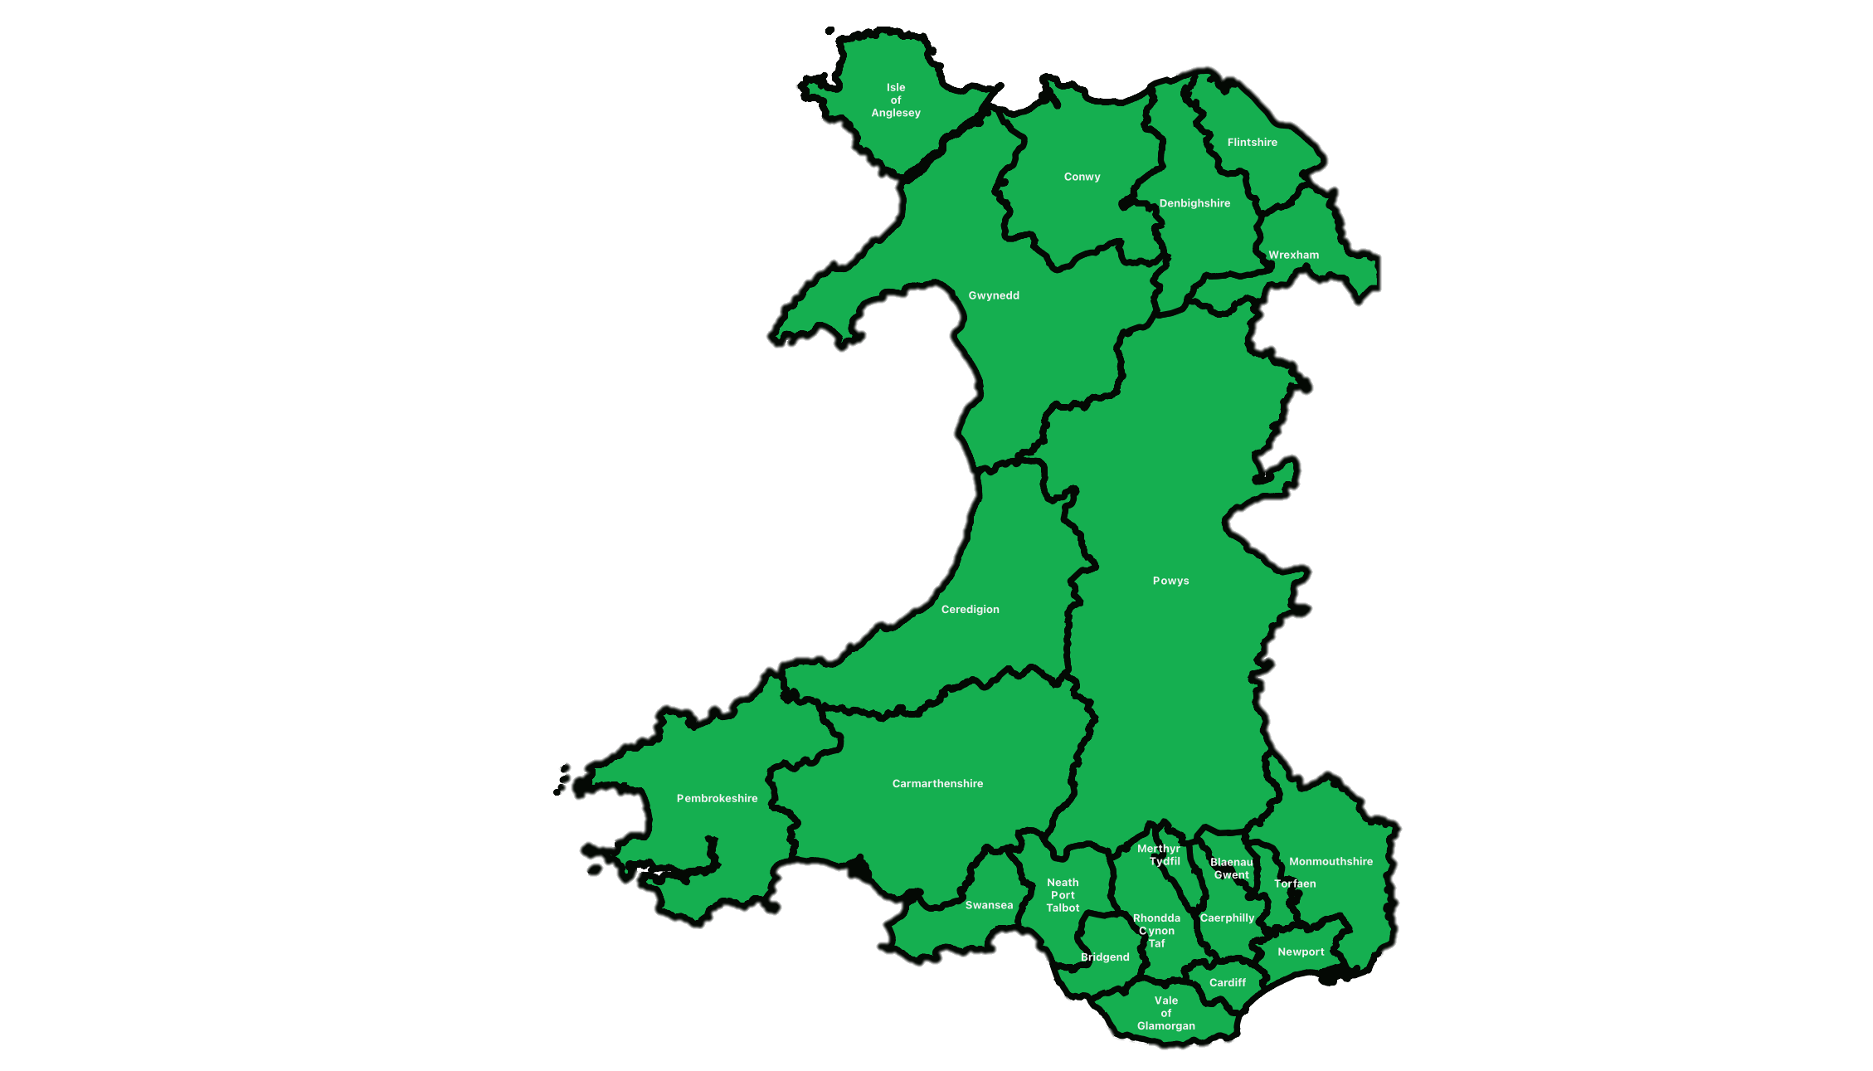
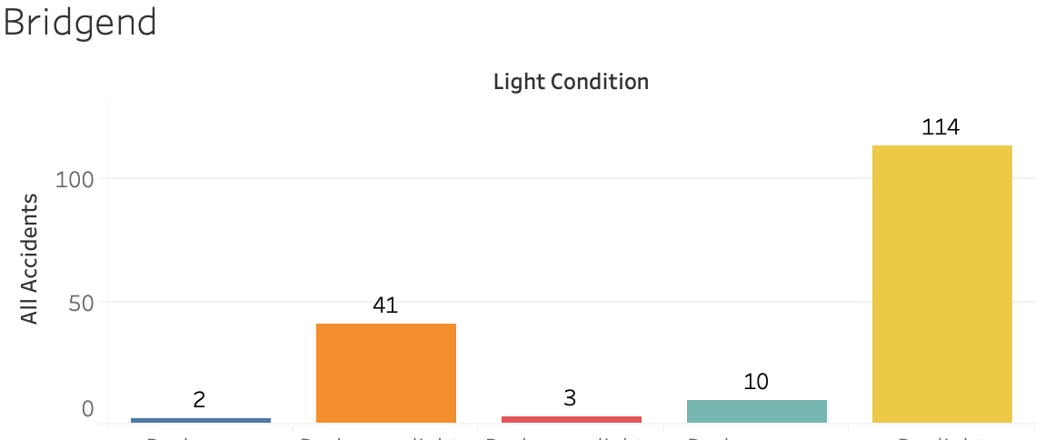
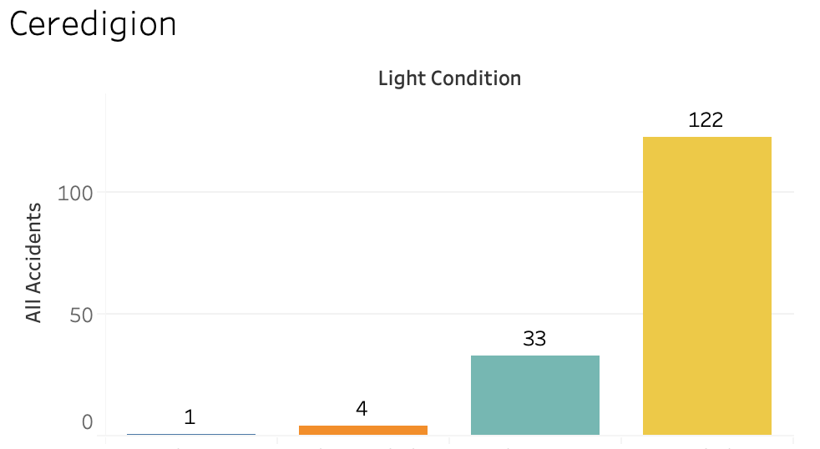
Total Crashes by Light Conditions in each Local Authority.
Give a brief ocverview

Slide 6
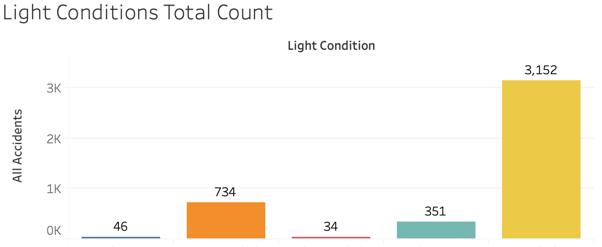
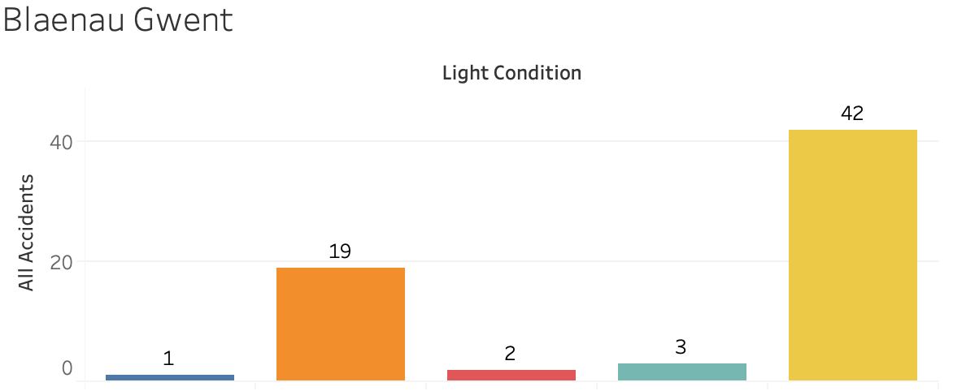
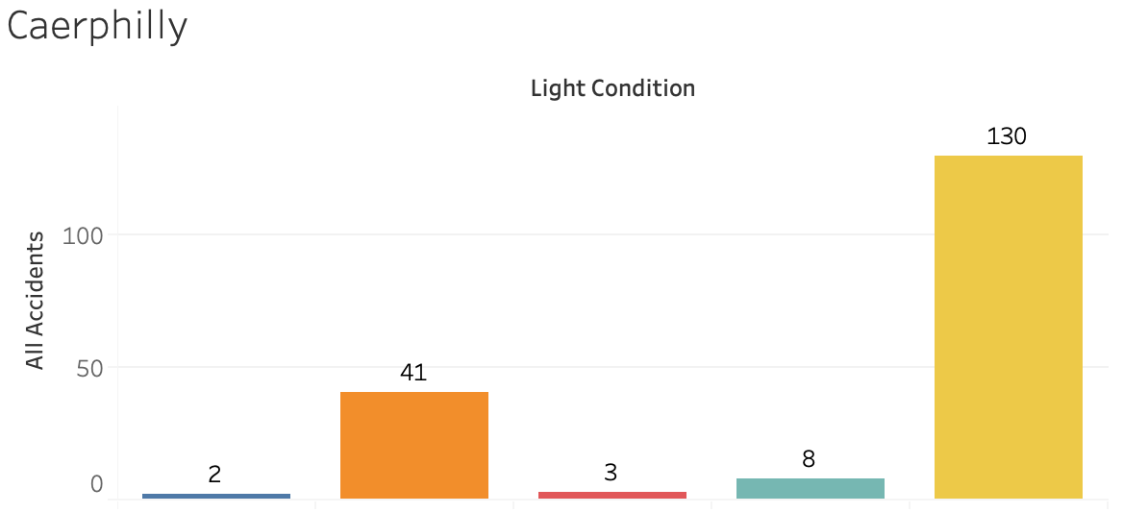
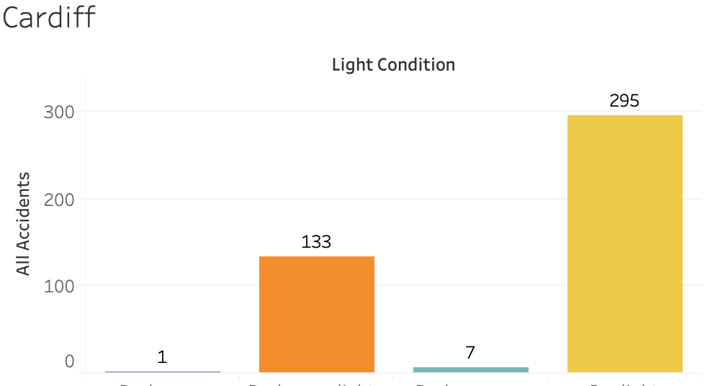
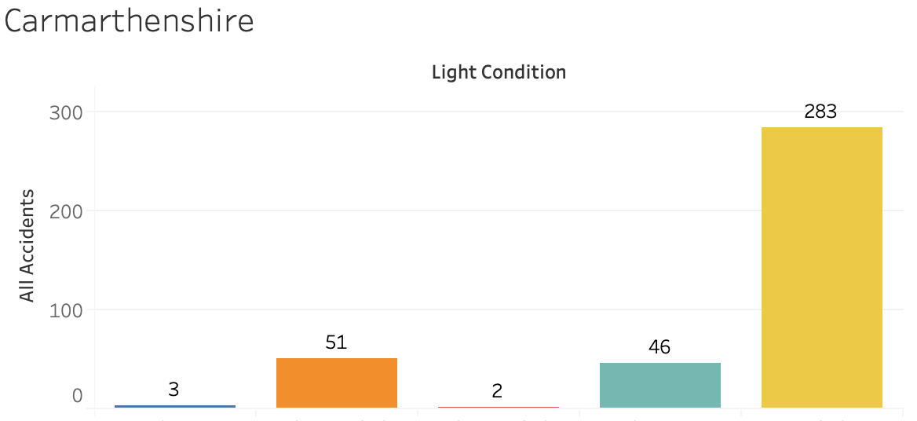
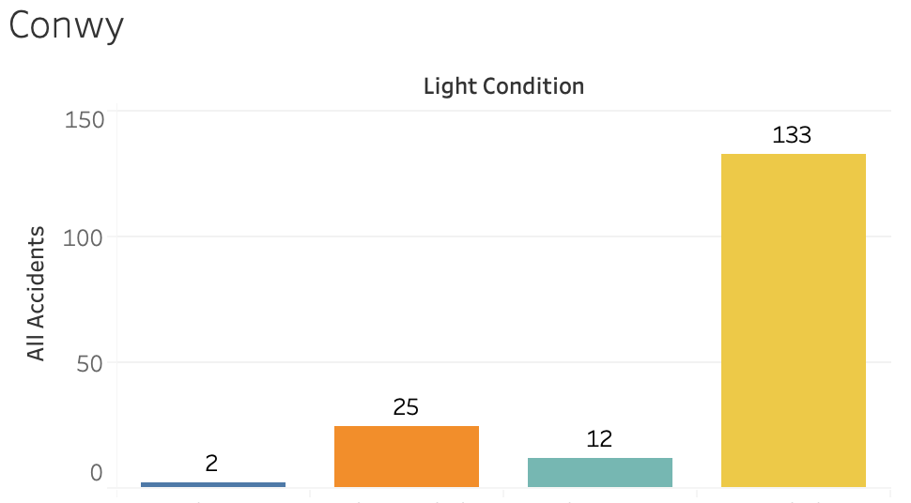
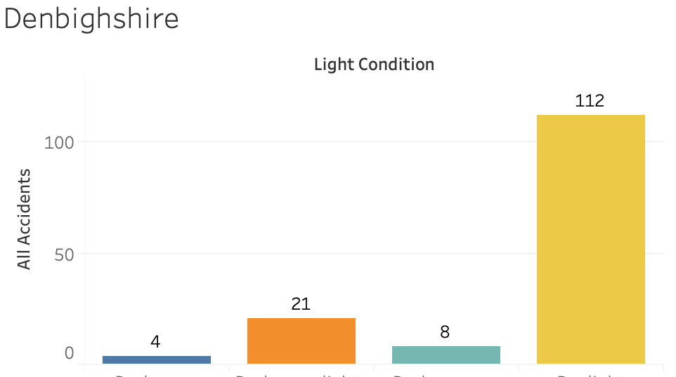
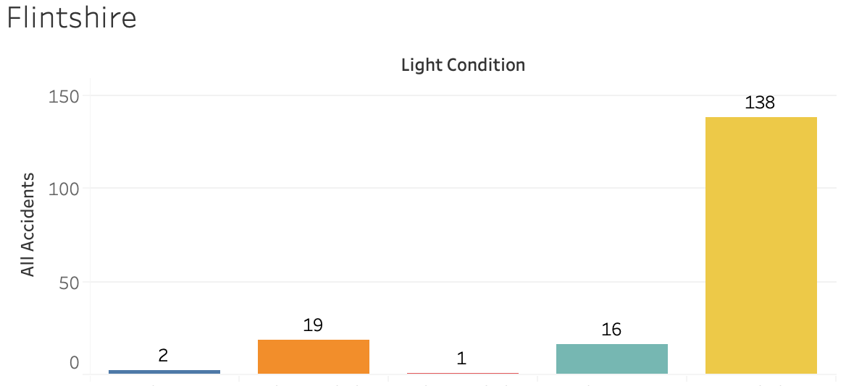
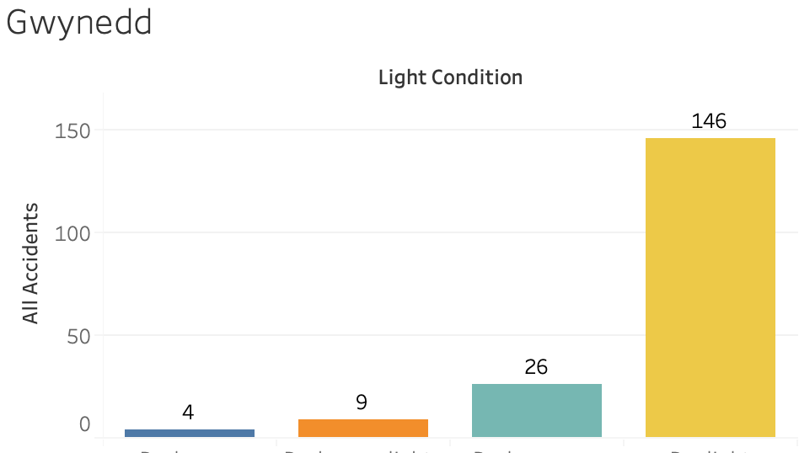
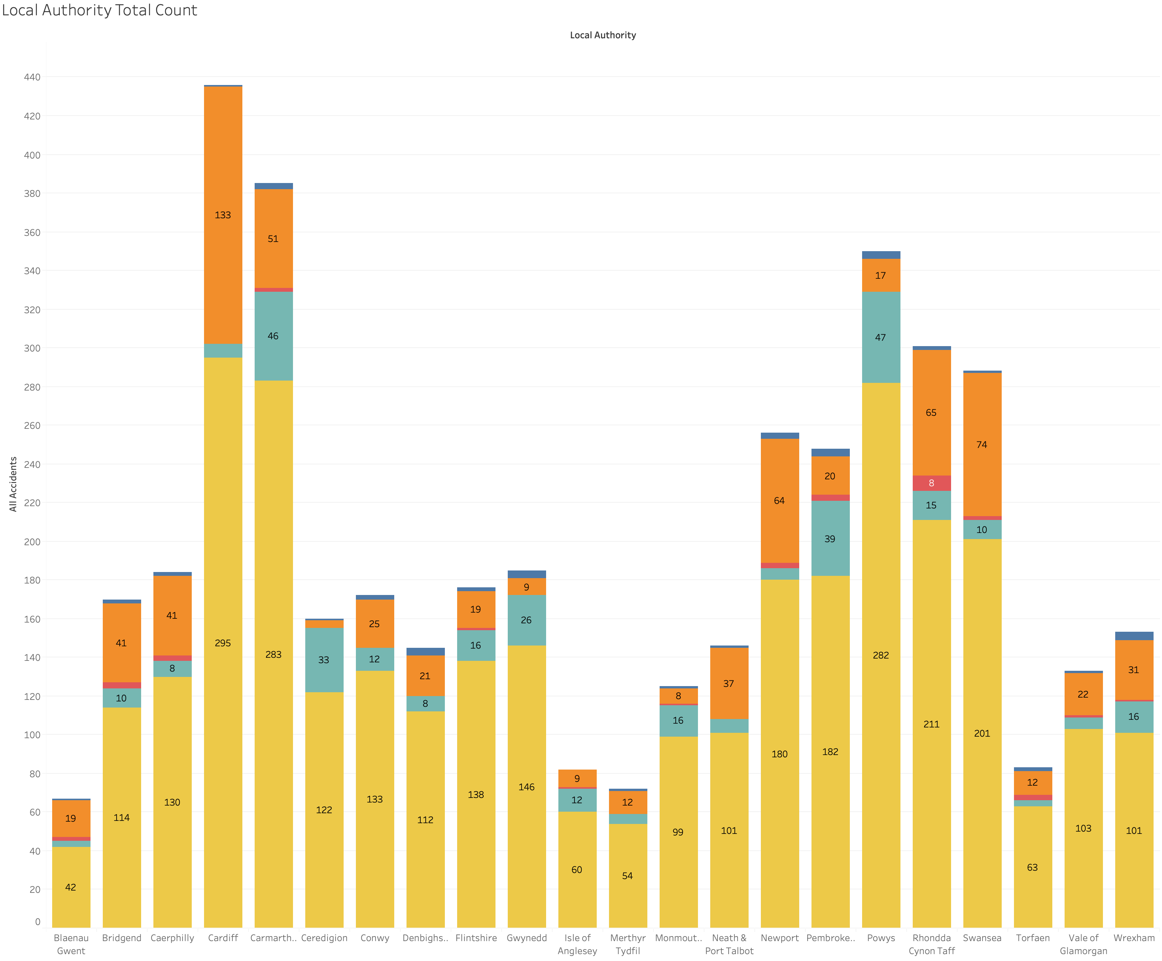
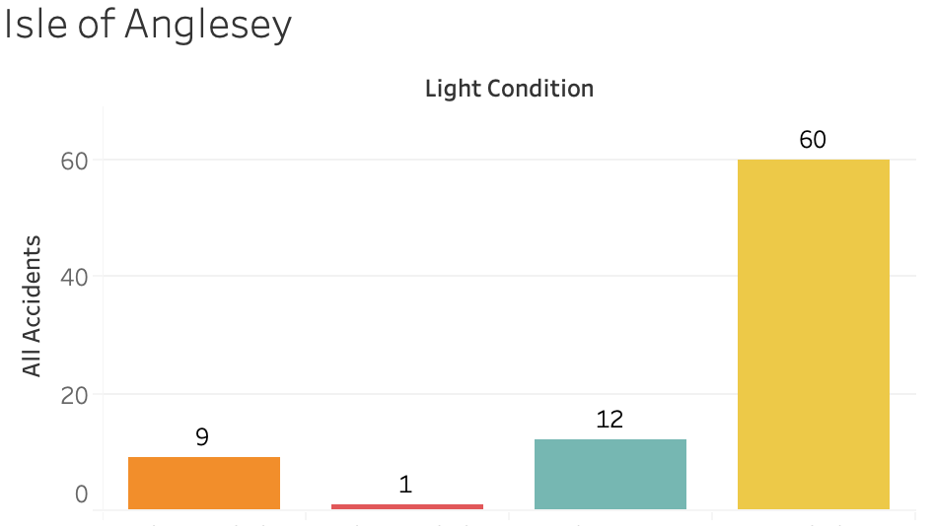
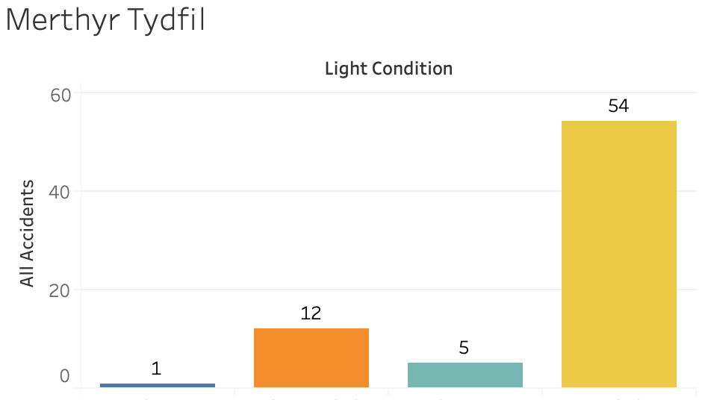
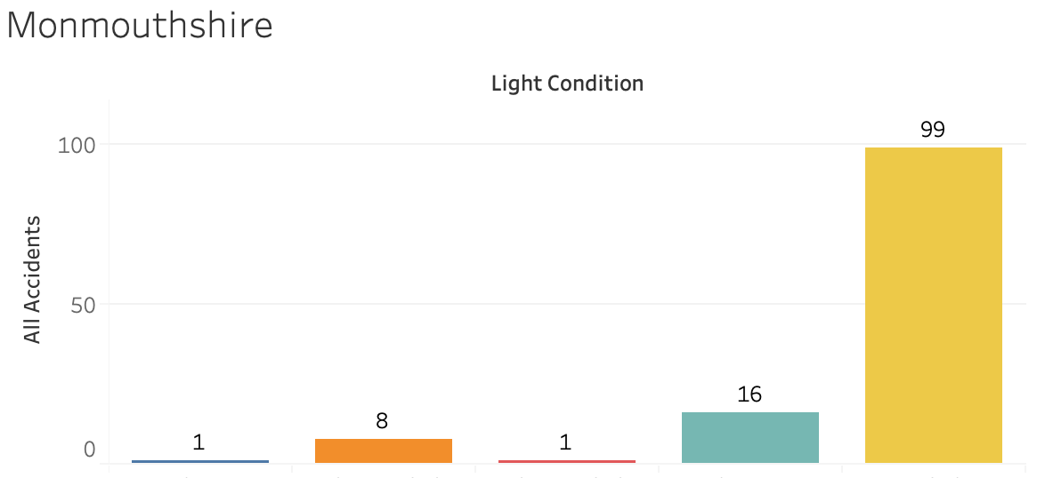
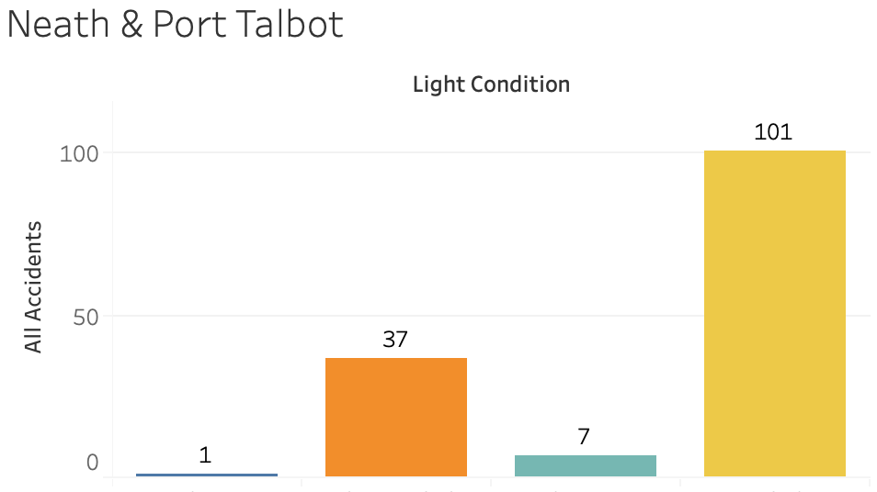
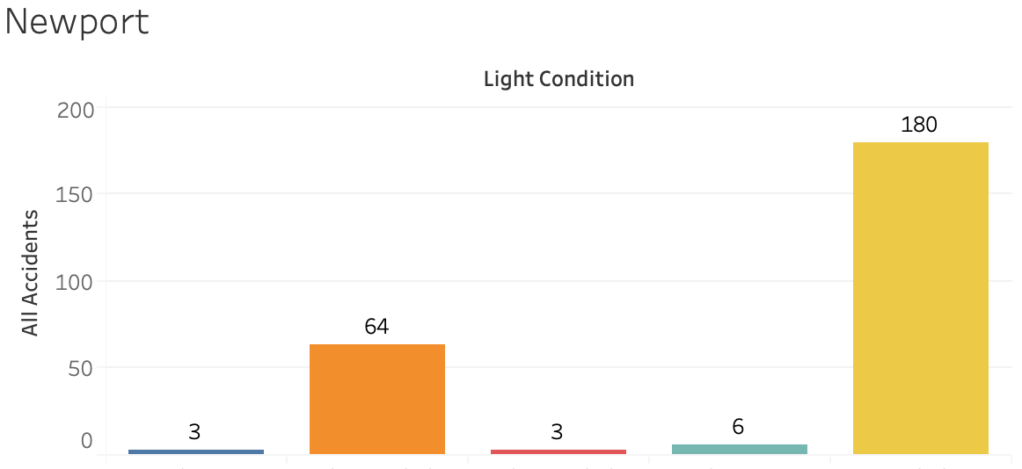
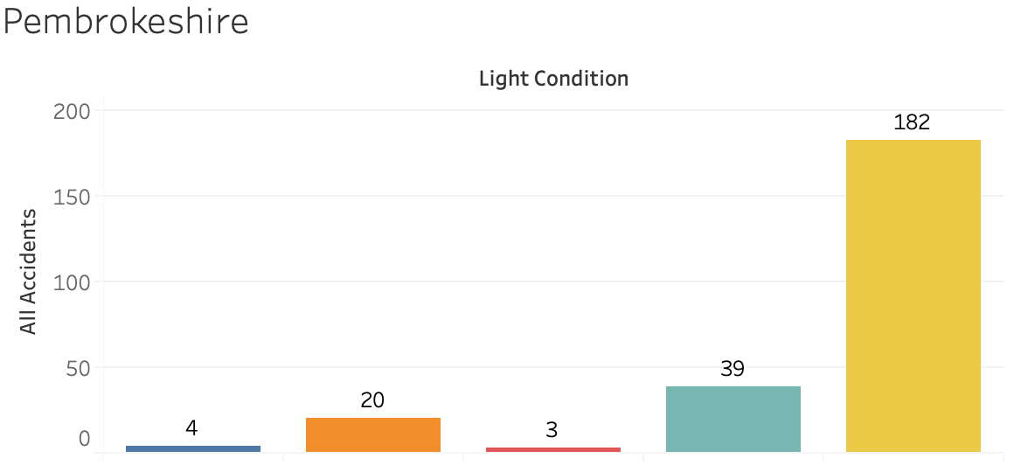
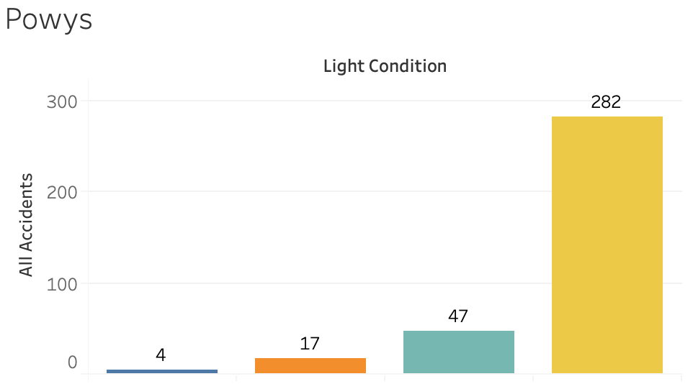
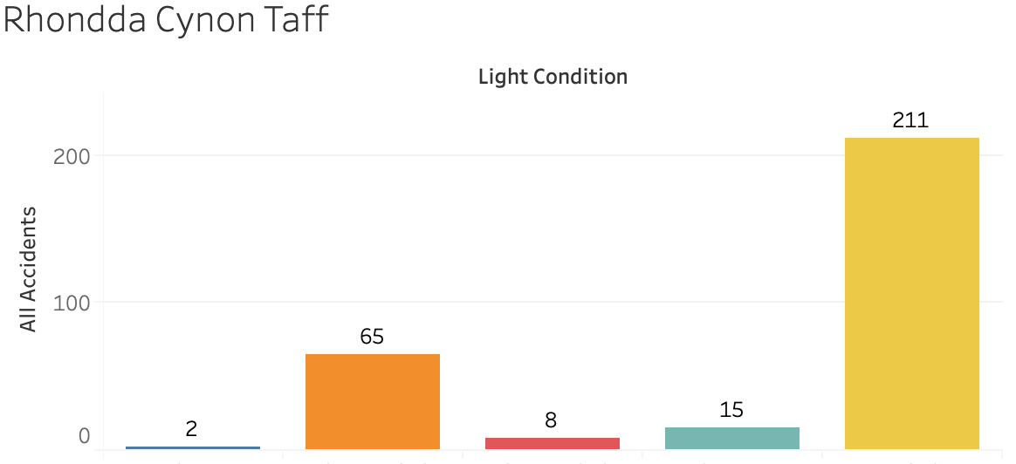
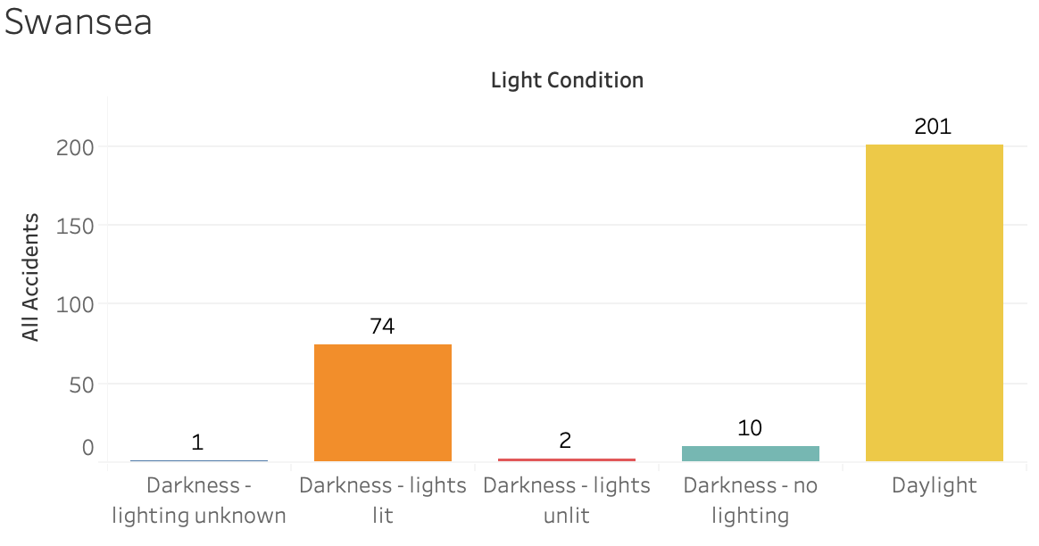
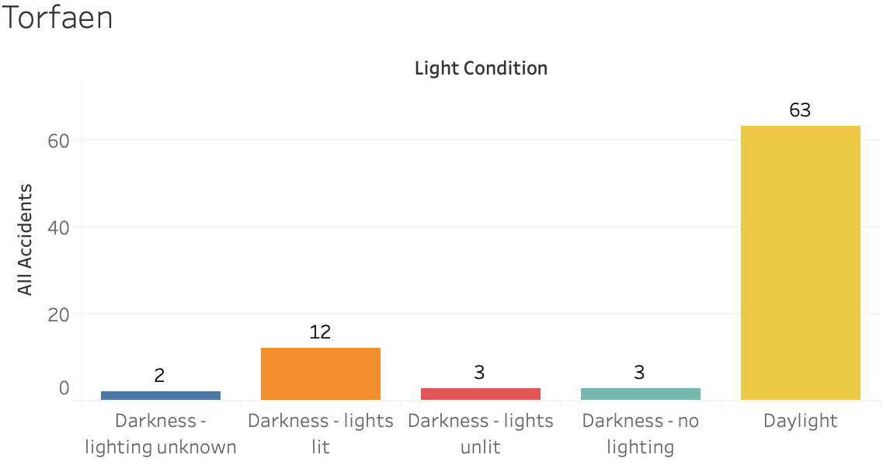
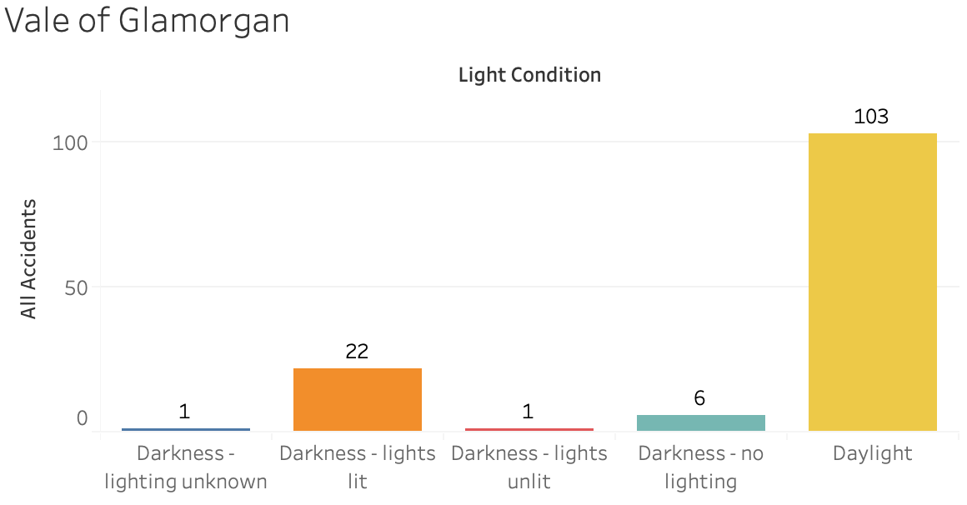
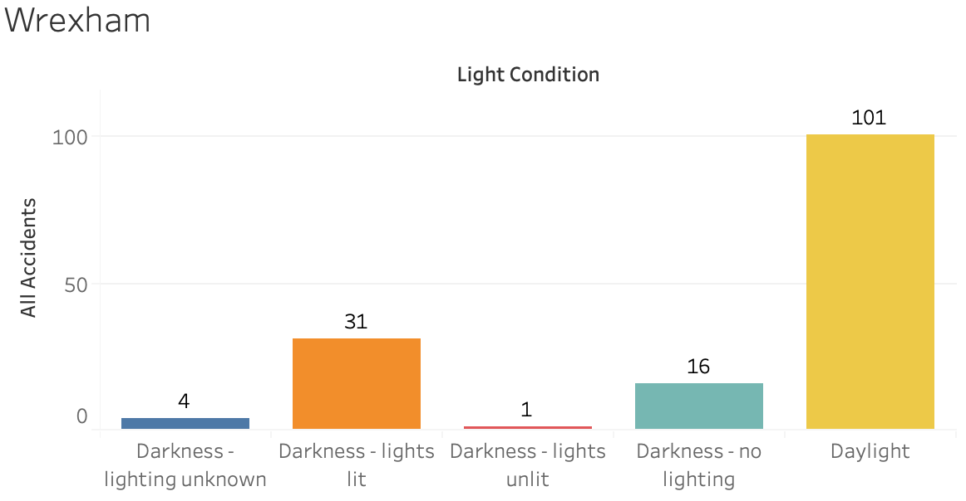
Total Crashes by Light Conditions in each Local Authority in Wales
Overview
The “Reported road accidents, Great Britain” dataset, is provided by the UK Government, licenced by Open Government Licence. The dataset contains road accidents in GB by severity, geography, year, local authority, road class and weather conditions in 2019. The different types of roads tracked are motorways, A, B, C and unclassified roads. A total of 4,317 observations. All observations get used while the light conditions and local authority categorised the data. The total sum of each accident got used.
Notes:
9.5 cm
17.68 cm

Slide 7

Total Crashes by Light Conditions in each Local Authority in Wales
Overview
The “Reported road accidents, Great Britain” dataset, is provided by the UK Government, licenced by Open Government Licence. The dataset contains road accidents in GB by severity, geography, year, local authority, road class and weather conditions in 2019. The different types of roads tracked are motorways, A, B, C and unclassified roads. A total of 4,317 observations. All observations get used while the light conditions and local authority categorised the data. The total sum of each accident got used.
Highest
Lowest
Notes:
9.5 cm
17.68 cm

Slide 8

Total Crashes by Light Conditions in each Local Authority in Wales
Overview
The “Reported road accidents, Great Britain” dataset, is provided by the UK Government, licenced by Open Government Licence. The dataset contains road accidents in GB by severity, geography, year, local authority, road class and weather conditions in 2019. The different types of roads tracked are motorways, A, B, C and unclassified roads. A total of 4,317 observations. All observations get used while the light conditions and local authority categorised the data. The total sum of each accident got used.
Highest
Lowest
Notes:
9.5 cm
17.68 cm

Slide 9

Total Crashes by Light Conditions in each Local Authority in Wales
Overview
The “Reported road accidents, Great Britain” dataset, is provided by the UK Government, licenced by Open Government Licence. The dataset contains road accidents in GB by severity, geography, year, local authority, road class and weather conditions in 2019. The different types of roads tracked are motorways, A, B, C and unclassified roads. A total of 4,317 observations. All observations get used while the light conditions and local authority categorised the data. The total sum of each accident got used.
Highest
Lowest

Slide 10

Total Crashes by Light Conditions in each Local Authority in Wales
Overview
The “Reported road accidents, Great Britain” dataset, is provided by the UK Government, licenced by Open Government Licence. The dataset contains road accidents in GB by severity, geography, year, local authority, road class and weather conditions in 2019. The different types of roads tracked are motorways, A, B, C and unclassified roads. A total of 4,317 observations. All observations get used while the light conditions and local authority categorised the data. The total sum of each accident got used.
Highest
Lowest
Notes:
Final Design.

Slide 11

Total Crashes by Light Conditions in each Local Authority in Wales
Overview
The “Reported road accidents, Great Britain” dataset, is provided by the UK Government, licenced by Open Government Licence. The dataset contains road accidents in GB by severity, geography, year, local authority, road class and weather conditions in 2019. The different types of roads tracked are motorways, A, B, C and unclassified roads. A total of 4,317 observations. All observations get used while the light conditions and local authority categorised the data. The total sum of each accident got used.
Highest
Lowest
Notes:
9.5 cm
17.68 cm

Slide 12

Total Crashes by Light Conditions in each Local Authority in Wales
Overview
The “Reported road accidents, Great Britain” dataset, is provided by the UK Government, licenced by Open Government Licence. The dataset contains road accidents in GB by severity, geography, year, local authority, road class and weather conditions in 2019. The different types of roads tracked are motorways, A, B, C and unclassified roads. A total of 4,317 observations. All observations get used while the light conditions and local authority categorised the data. The total sum of each accident got used.
Highest
Lowest
Notes:
9.5 cm
17.68 cm

Slide 13
Notes
Full UK map to show the location associated to whole of UK. Made wales pink for this to allow the the area to be seen quickly.
Text added to views can see what the name of the areas are called.
Added Wales Principle areas to show the different areas on the map.
Text size 18
Slight shadow to make the text pop.
Similar pastel colours
Text: wrapped letters on 2 characters/ Type Case: Title Case
Tried to lay out charts like the co-ordinates of the map
Used same colour coding for the different light conditions.
Tried using a logarithmic scale, but felt that the scale made it hard to read at a glance.
Colour Code map to show hot spot areas -> didn’t have enough know how on QGIS.
Only had relevant axis titles on the out side charts. To remove the clutter in the middle and repetition.

